Slide 1

Summer Reading Jumpstart
May 2017

Slide 2
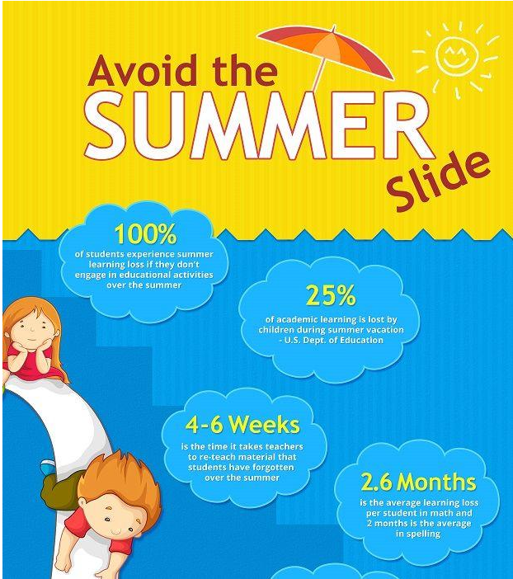
https://www.youtube.com/watch?v=5Gm68Ovhc0M

Slide 3

Carrollton Public Library
Carrollton Public Library
(Hebron & Josey)
4220 N. Josey Lane at Hebron Pkwy.
Carrollton 75010
972-466-4800
Carrollton Public Library
(Josey Ranch Lake)
1700 Keller Springs Road
Carrollton 75006
972-466-4800
Library Website: http://bit.ly/2pU7ohc

Slide 4

Dallas Public Library
Dallas Public Library (Timberglen)
18505 Midway Road (corner of Midway and Timberglen)
Dallas 75287
214-671-1365
Library Website: https://dallaslibrary2.org/

Slide 5

Reading Takes You Places- Sheffield
Library Website:
http://bit.ly/2e6fT6P
Library Resources : http://goo.gl/fWbzWm

Slide 6

Other Summer Reading Programs
Barnes and Noble (English): http://bit.ly/2pUYtwZ
Barnes and Noble (Spanish): http://bit.ly/2qsx6gj
Chuck E. Cheese (English): http://bit.ly/2lwLRgO
Chuck E. Cheese (Spanish):http://bit.ly/2rs4Yss
Half Price Books:
https://www.halfpricebooks.com/fyb/

Slide 7



For Parents
Common Sense Media
https://www.commonsensemedia.org/
http://www.readingrockets.org/
http://www.colorincolorado.org/

Slide 8

Reading Lists
Dallas Public Library- http://bit.ly/2pTTN9H
Carrollton Public Library- http://bit.ly/2pRYPUZ
Read Kiddo Read- http://www.readkiddoread.com/
Barnes and Noble: http://bit.ly/1KcIDFy

Slide 9



For Reading
Starfall (Pre-K-2nd)
http://www.starfall.com/
Riverdeep (on Student Digital Resources)
http://bit.ly/2dynN90
ABCYa.com (Pre-K-5)
http://www.abcya.com/
Library Resources Page- Tumblebooks/ Pebble Go/ TrueFlix
http://goo.gl/fWbzWm

Slide 10

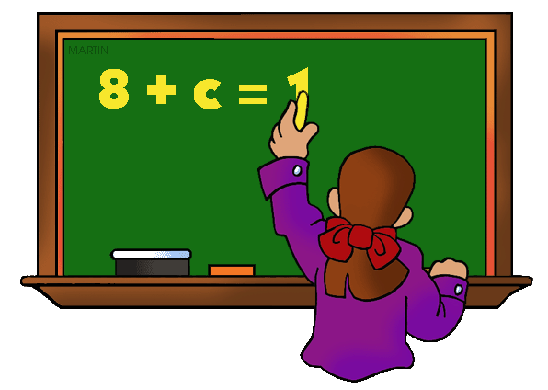
For Math
Prodigy
https://www.prodigygame.com/
Riverdeep (on Student Digital Resources)
http://bit.ly/2dynN90

